Slide 1



Superstore profit
View in Power BI
Last data refresh:
29-06-2023 10:23:22 UTC
Downloaded at:
29-06-2023 10:24:56 UTC

Slide 2
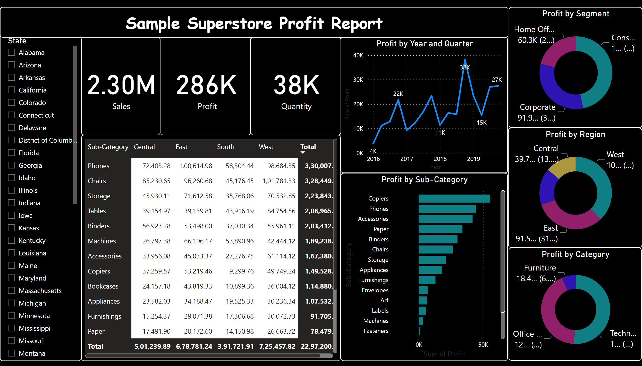
Page 1
Notes:
card
No alt text provided
card
No alt text provided
card
No alt text provided
pivotTable
No alt text provided
slicer
No alt text provided
textbox
No alt text provided
Profit by Year and Quarter
No alt text provided
Profit by Sub-Category
No alt text provided
Profit by Region
No alt text provided
Profit by Segment
No alt text provided
Profit by Category
No alt text provided

